Slide 1
Findings on NHS Data Set
Presented By
Amit Pandit
Data Analyst Trainee
CodeClan

Slide 2
The Task
In order to help inform the planning for provision of cancer treatment services in NHS Borders, we would like to gain better understanding of the incidence of cancer in NHS Borders.

Slide 3
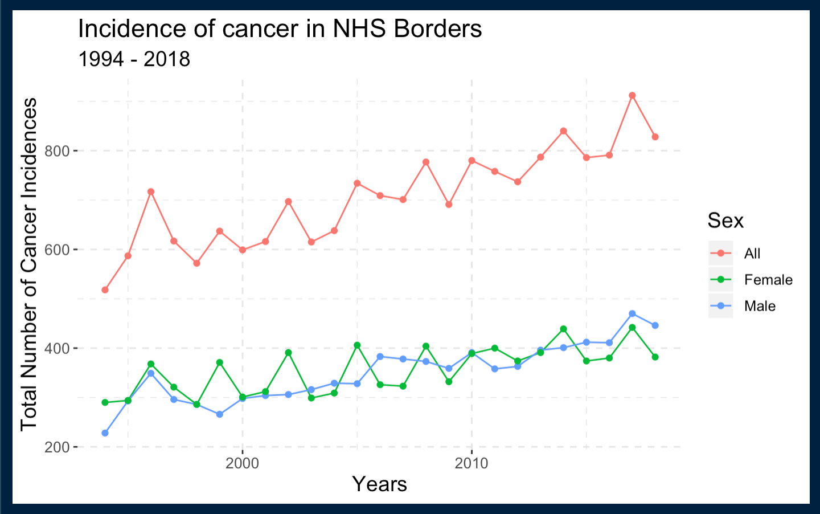
The Findings
We can see that there has been a steady growth in the Cancer Incidences both in the Male and Female Population since 1994 to 2018.
Although post 1996 till 2004 the total incidences was observed to be below 700, there has been a considerable increase in the number of Incidences since then.

Slide 4
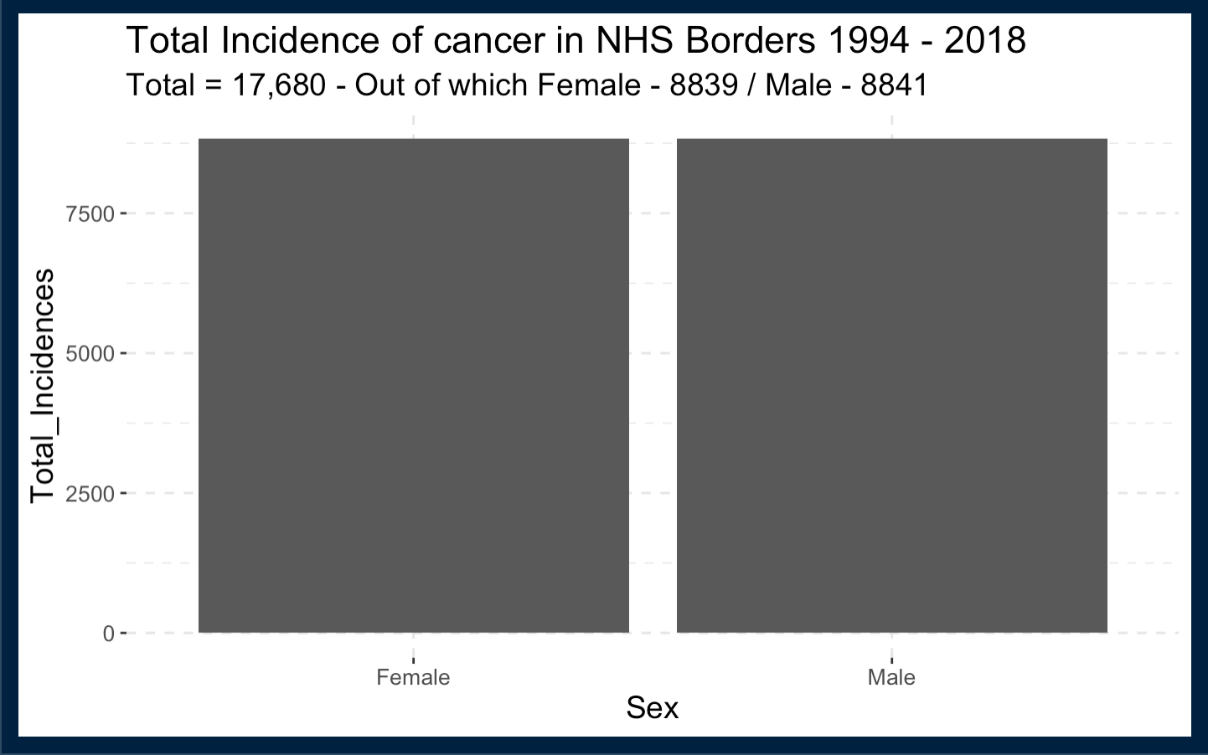
We can see that interestingly the number of incidences in both Female & Male population has been split exactly by 50%

Slide 5
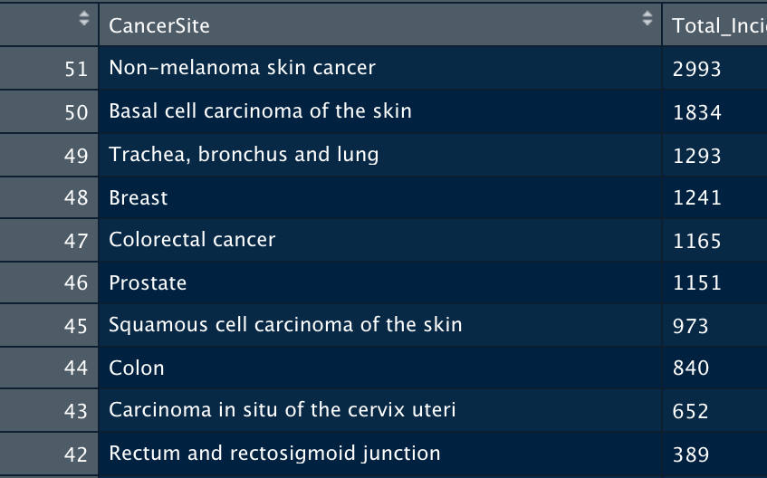
These are 10 Most Commonly Occurred Cancer Incidences in the Borders along with the total number of incidences, starting from 1994 to 2018

Slide 6


Thank You

